Slide 1

Let em Cook!
A4: Concept Video
Mayowa A. Butch N. Esaw A. Tina Z.

Slide 2
Problem
People aren't willing to explore and get out of their comfort zone while cooking because it is not enjoyable enough.
Getting individuals living independently for the first time out of their comfort zone (regarding cooking/food)

Slide 3
Solution
A Social Cooking App that incentivizes individuals to explore cooking by offering unique challenges, virtual rewards, and opportunities for interactions with other users
Getting individuals living independently for the first time out of their comfort zone (regarding cooking/food)

Slide 4
Primary Users
Young adults living independently for the first time, who need some extra motivation to start cooking and getting out of their zone in a safe environment.
Getting individuals living independently for the first time out of their comfort zone (regarding cooking/food)

Slide 5
Name, One-Liner, Value Proposition
Name: Let 'em Cook!
We wanted a name that emphasized our app's fun nature, as well as embodying the efforts of people trying new things with new ingredients, and how trusting the process and having faith in oneself can shine through as a novel, fun experience!
One-Liner
“Make your kitchen a playground!”
We think "Let 'em Cook!" will be short enough to act as a motto, so we chose a one-liner that gets to the core of our product's intended features and outcome. This one-liner unites some of the core tasks we envision for our product, and it makes clear that while app has many facets, they all contribute to solving our problem and making cooking enjoyable.

Slide 6
Market Research
Social Cooking Apps
+
Cooking Apps that Encourage Exploration

Slide 7

Spice
SIMILARITIES
Social/guiding app. Promotes cooking "challenges" (recipes to follow) and "duels" to cook with friends. Goal: Make cooking not feel "like a chore".
DIFFERENCES / WHAT MAKES US UNIQUE
We make cooking fun via not only competition, but social validation (sharing photos, interactions with strangers). Our challenges are open-ended prompts that inspire more creativity and truly Let 'Em Cook. Our solution emphasizes getting out of one's comfort zone so users grow as individuals. Spice relies on "quick tips" rather than a habit of exploration.
WHAT WORKS/DOESN'T
Worked: Sharing creations with friends and inviting them to a video chat to cook with you at the same time. Doesn't: interactive globe for community aspect
IMPLICATIONS
Interacting with friends is easier to implement; interacting with strangers is where our app shines! Also, allowing more open-ended freedom and creativity will let people truly discover the fun of cooking!

Slide 8

FoodDex
SIMILARITIES
Encourages exploring new culinary cultures with badges as reward for a "passport." Users can share photos with friends and choose recommended recipes to get started cooking. Has consideration for dietary restrictions.
DIFFERENCES / WHAT MAKES US UNIQUE
Our app provides recommendations to users not based solely on a country of origin of the dish, but on other aspects such as ingredients and dietary restrictions. Our social aspect allows sharing with both friends and the larger world. Our app's competitive feature allows for more active involvement and interaction among users to keep everyone engaged.
WHAT WORKS/DOESN'T
Worked: Sharing creations with friends and virtual badges/passport.
Doesn't: Self-selection and task initiation for recipes was a lot for inexperienced cooks.
IMPLICATIONS
Our app's ability to share with strangers sets us apart! Collection for virtual rewards appears to be a valid incentive. For our tasks, we need to make task initiation easier, and reduce mental load on users - such as limiting their choices of recipe/challenge.

Slide 9

Sidekick by Sorted Food
SIMILARITIES
Goal of having less experienced cooks experiment with cooking and broaden horizons. Will provide list of groceries to purchase to fulfil a recipe.
DIFFERENCES / WHAT MAKES US UNIQUE
Sidekick has no social/competitive aspect. Our users can input/have choice on their challenges, where Sidekick provides a shopping list and recipes with minimal agency. Sidekick has no consideration for dietary restrictions
WHAT WORKS/DOESN'T
Worked: provides a list of ingredient to purchase for a recipe. Doesn't: users have minimal choice, and some cannot follow recipe based on dietary restrictions
IMPLICATIONS
An important part of our design becoming successful is the diversity of challenges users can experience in the app, and the agency they have in creating and undertaking them. User input will keep things diverse, and keep our app engaging!

Slide 10

Pepper
SIMILARITIES
Social app to encourage cooking through seeing your feed and interacting. Includes a virtual charcuterie board to decorate after participating in the app's features.
DIFFERENCES / WHAT MAKES US UNIQUE
Our virtual decoration process is more personable (choose the rewards you want to accessorize your parasocial pal, instead of adding foods to a charcuterie board). Our competitive aspect is also unique.
WHAT WORKS/DOESN'T
Worked: Having a feed of recipes that others, including pro chefs, post. Doesn't: Dietary restrictions are self-filter, integration into daily life wasn't smooth for most.
IMPLICATIONS
We should be aware of moderation, since Pepper's lack of moderation made the app feel "intense" to use. Also, integration into a daily routine was hard for Pepper users who had to search recipes themselves. Easy to choose challenges and competition should encourage habitualization.

Slide 11
Market Research Overview
Feature
Competitiveness
Send Pictures (Friends/Strangers)
/
/
/
/
/
Collectible Rewards
Recipe Selection/
Choices
Accommodate Dietary Restrictions
*
* = Self-Filter

Slide 12
Values in Design
Stakeholders
+
Ethical Implications

Slide 13
Explored Solution/Task:
Competitive Cooking
Users cook from same prompt, same ingredients options, then post photos to compare.

Slide 14
Competitive Cooking Stakeholders
Direct:
Indirect
Users (young adults living independently for first time)
  Includes user's friends who become users themselves!
Sellers of ingredients chosen for challenges (local merchants, large grocery stores, etc.)
Those living with/interacting with users while they cook/shop for groceries
Chefs/Cookbooks/Sources of recipes either used in-app or used by users

Slide 15

Competitive Cooking Ethics (Tarot Cards)
Mother Nature
Generally, our app is good for the environment encourages cooking at home, which is more sustainable (especially if users have ingredients at home already)
A potentially harmful aspect is food waste - users may get more attached to "winning" competition or taking pictures than actually eating their creation
  The absence of tangible rewards (e.g. money) should reduce risk of this issue.
  We can also limit virtual rewards possible per day, to reduce possibility of person attempting to win every competition possible.
Q: If the environment was your client, how would your product change? What feedback would the environment give about your product? What is the most unsustainable behavior your product encourages?

Slide 16

Competitive Cooking Ethics (Tarot Cards)
The Forgotten
Our user base may be more exclusive towards those with dietary restrictions - rewarding experimentation may reduce opportunities for these individuals to participate in the same way.
  We can tailor our app to be more generalized towards the most common dietary restrictions, and allow users to create their own custom challenges that accomodate more extreme restrictions
  Users may use challenges to help others better understand their experience of accommodating their own dietary restrictions!
Q: When you picture your user base, who is excluded? If they used your product, what would their experience be like?

Slide 17

Competitive Cooking Ethics (Tarot Cards)
The Siren
Using our product too much would include users scrolling others' post excessively, or consistently try to undergo challenges in attempts to earn the virtual reward.
Overuse would go against the goal of the app (focusing on exploring and making cooking enjoyable) in favor of an addictive need to acquire an artificial reward. This can lead to food waste or toxic interactions among users,.
We can address overuse by emphasizing the fun, interactive nature of challenges, and limiting the number of challenges one can participate in and/or the number of rewards one can earn in a set time.
Q: What would using your product "too much " look like? How does your product encourage users to engage, and how does it make it easy to disconnect?

Slide 18
Task Breakdown
(Each row goes left to right)

Slide 19
Simple Tasks - Simple
Select recipe/challenge to cook
Check out what others have cooked!
Users will be presented a recipe to use or
Users can choose among a limited (3) number of challenges to undertake for a virtual reward.
These challenges come from a large bank, and can include ingredients, cooking styles, certain cuisines, etc.
Expected Daily interactive usage.
Simple because there is minimal additional effort (recipe/challenges premade)
Video Timestamp: ~0:20-0:26
Users can see photos of others' challenges (friends or general population) for the past few days, and share opinions
Like, comments, repost, other interactive measures of success
Users can share their methods/techniques, get inspiration from what others have done, and receive thoughts/feedback from other users.
Simple because users are likely accustomed to social media already, and performing this task can take as little as seconds!
Video timestamp: ~0:44-0:50

Slide 20
Tasks - Moderate
Invite friends to participate in existing challenge
Users can invite other friends to participate in an already-listed challenge.
Both users receive information about the challenge's conditions, ingredients, and time of occurrence.
Both users can share what they create and compare!
Moderate because user needs to take some additional initiative (finding a challenge they like, finding a friend they think would like the challenge, actively sending the challenge, having the challenge be accepted by the friend).
  Expectation that users share their results afterwards. This might be more intimidating for very beginning chefs/users who are less comfortable sharing what they've done.
Video Timestamp: 1:15-1:19 (person walking over to invite friend)

Slide 21
Tasks - Complex
Create a custom challenge!
Users can create a custom challenge and send them to other users (either friends or the general user base) to explore/undergo.
  Users can modify things such as time limit, ingredients list, culinary + dietary restrictions, banned cooking methods, or more.
Complex task because it takes initiative and active experience to determine a combination of restrictions that makes a challenge both fun, but still possible for their target audience (friends or people in general)
  Really pushes the limits of creativity on both the creator and undertaker's side.
Video Timestamp: 1:11-1:14

Slide 22
Storyboard

Slide 23
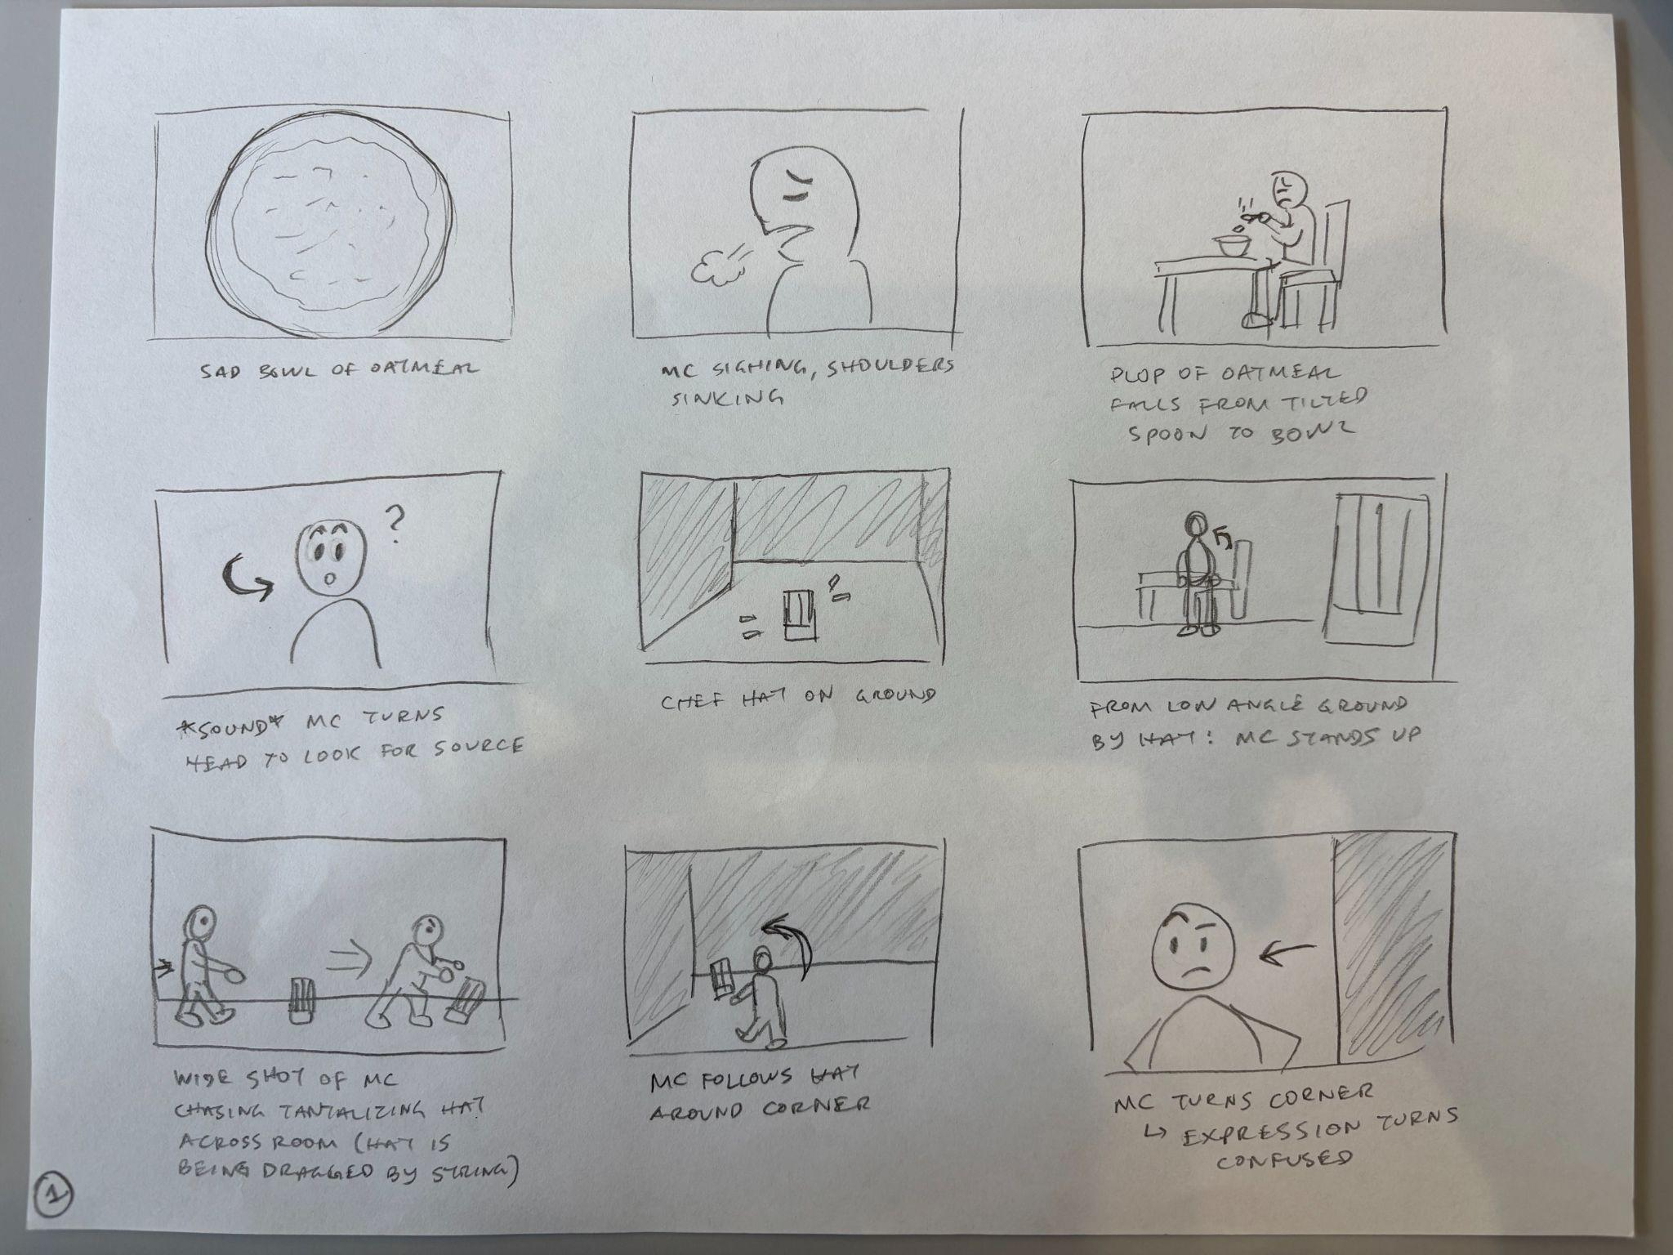
Storyboard
Introduction of conflict— Main character (MC) is sad because of boring, unappetizing meal
(implied that they cooked it themself, perhaps tired and unmotivated to cook something better)

Slide 24
Storyboard
*zoom in*
Introduction of solution— music change to highlight curiosity
(chef hat represents app/the potential aesthetic reward/the sense of pride from cooking)

Slide 25
Storyboard
Humorous chase scene that leads into introduction of solution pt. 2

Slide 26
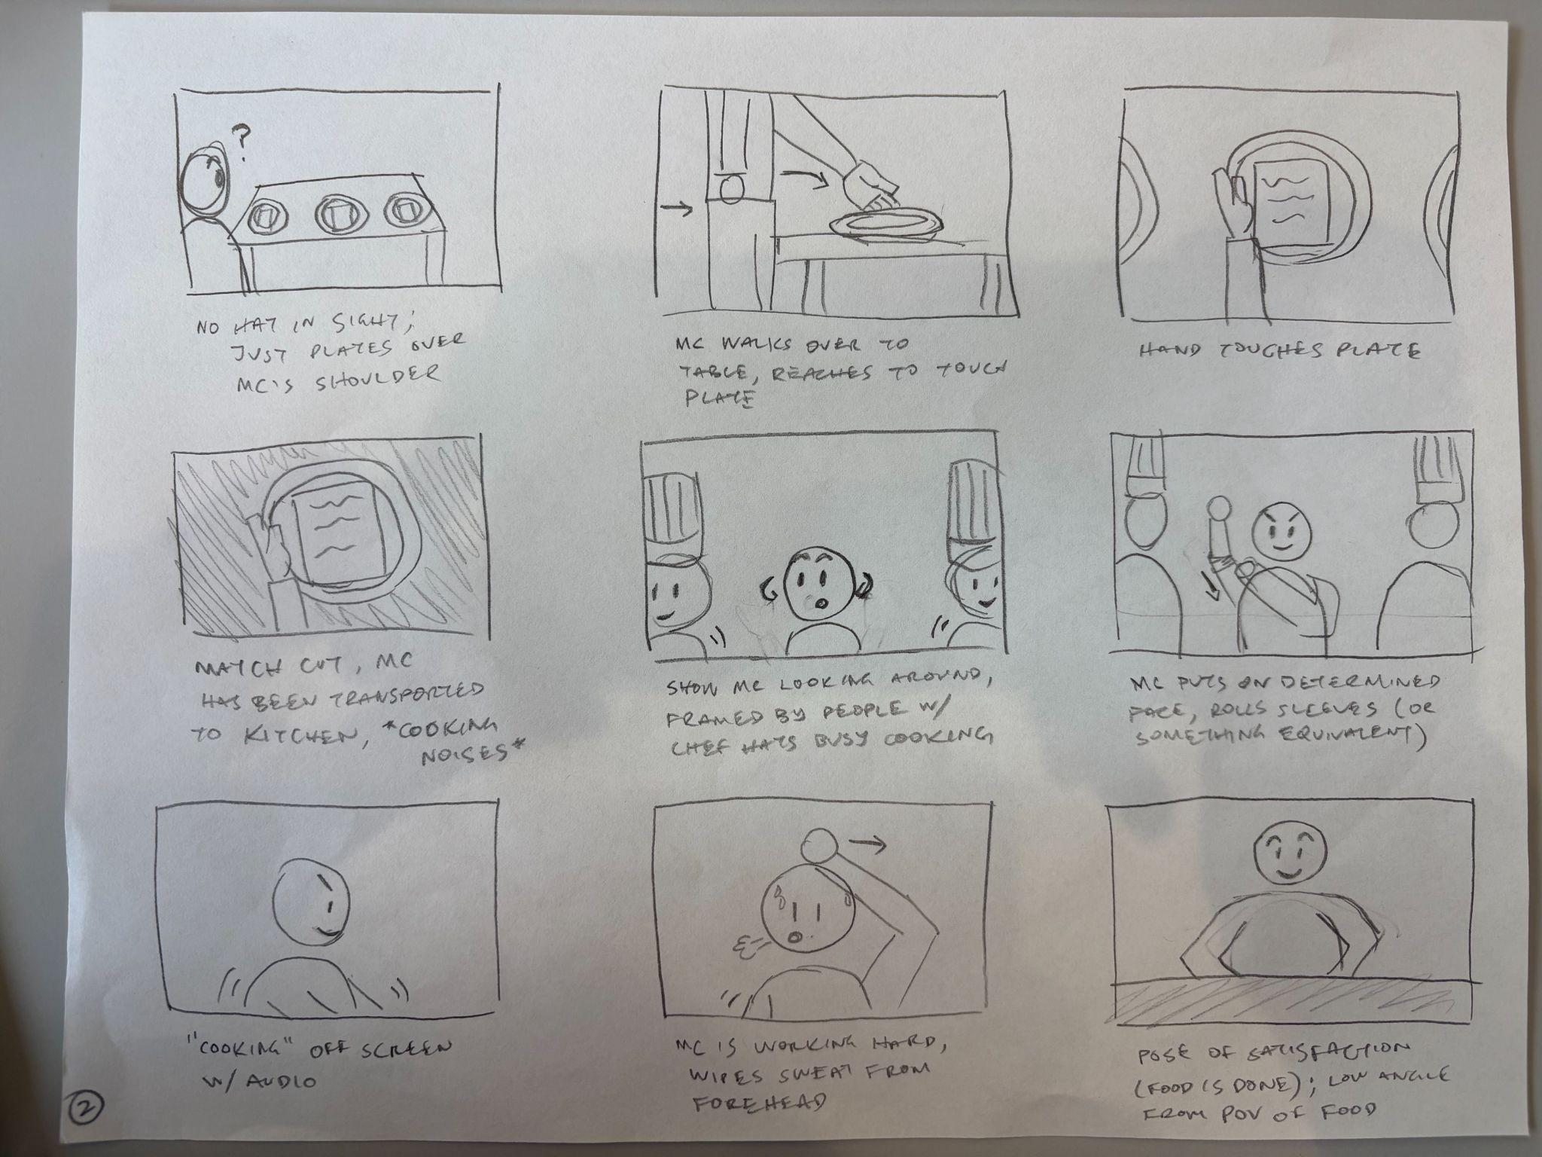
Storyboard
MC walks into frame
Potential challenges represented on each plate
MC is initially confused but becomes interested
Selects one— Simple Task 1

Slide 27
Storyboard
Solution (perhaps change in music to be energetic, accompanied by lively cooking audio)
MC is determined/competitive

Slide 28
Storyboard
Focus on MC working hard to cook meal, but emphasizing satisfaction
Climax

Slide 29
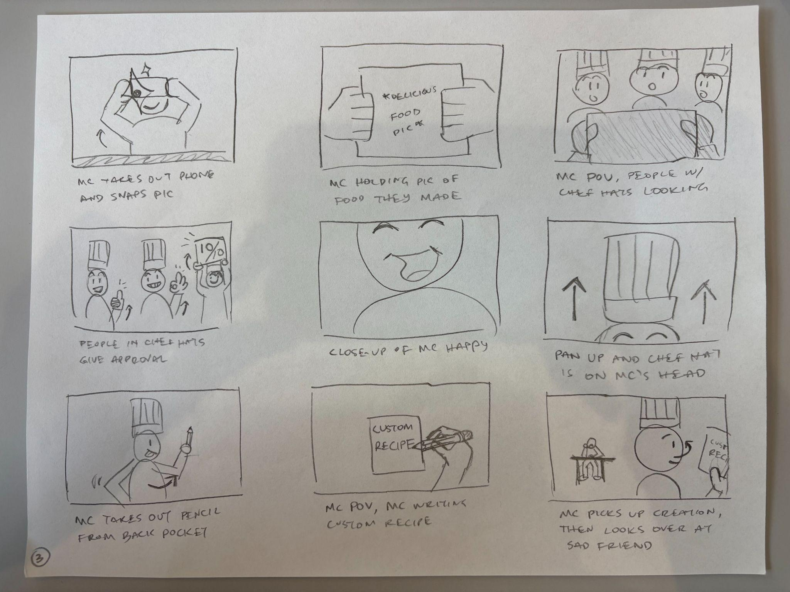
Storyboard
Still low angle from food POV
Snapping pic of food creation and showing it off to other users

Slide 30
Storyboard
Other users share their opinion on creation— Simple Task 2
MC is super happy— resolution of conflict
They earn the chef hat (reward/symbol of achievement)

Slide 31
Storyboard
Complex Task— MC creates custom challenge to share with sad friend
Introduction of next conflict

Slide 32
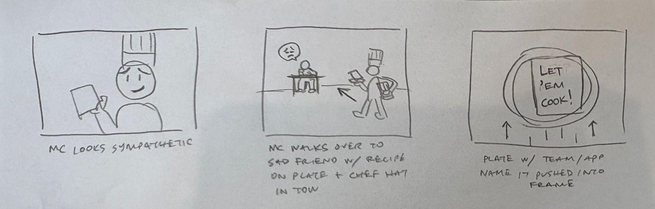
Storyboard
Implied resolution— MC will help sad friend have fun through cooking challenge
Story comes full circle
Sharing challenge with friend— Moderate Task

Slide 33
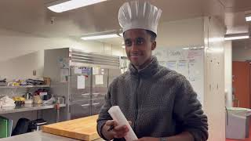
Concept Video
https://youtu.be/NBFhpcmP2MY (YT Video Link!)

